Slide 1



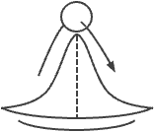


Dynamic instability
Longer food chains are less stable(Pimm and Lawton 1977)
Energy limitation
Due to energy loss at each transition, FCL can be high only at high basal energy
(Elton, 1927; Hutchinson 1959, Lindeman 1942)
P/R body size ratio
Stronger size structure favor longer food chains are less stable(Hairston and Conrad, 1979)

Slide 2
Environmental correlates
FCL
FCL
FCL
FCL
FCL
FCL
Human ftp
Flow
variability
Size
Lentic
Productivity
FCL
Lotic
Climate
Type
P/R ratios
Stronger size-structuring leading to longer food chains reduces chain stability (Hastings and Conrad, 1979)
Energy limitation
Due to energy loss at each transition, FCL can be high only at high basal energy
(Elton, 1927; Hutchinson 1959, Lindeman 1942)
Dynamic instability
Longer food chains are less stable
(Pimm and Lawton 1977)
Underpinning mechanisms

Slide 3
Potential Mechanisms at play
Environmental correlates
FCL
FCL
FCL
FCL
FCL
Lotic
Lentic
Human ftp
Size
Type
Flow
variability
FCL
Productivity
Climate
P/R ratios
Stronger size-structuring leading to longer food chains reduces chain stability (Hastings and Conrad, 1979)
Energy limitation
Due to energy loss at each transition, FCL can be high only at high basal energy
(Elton, 1927; Hutchinson 1959, Lindeman 1942)
Dynamic instability
Longer food chains are less stable
(Pimm and Lawton 1977)
Underpinning mechanisms

Slide 4
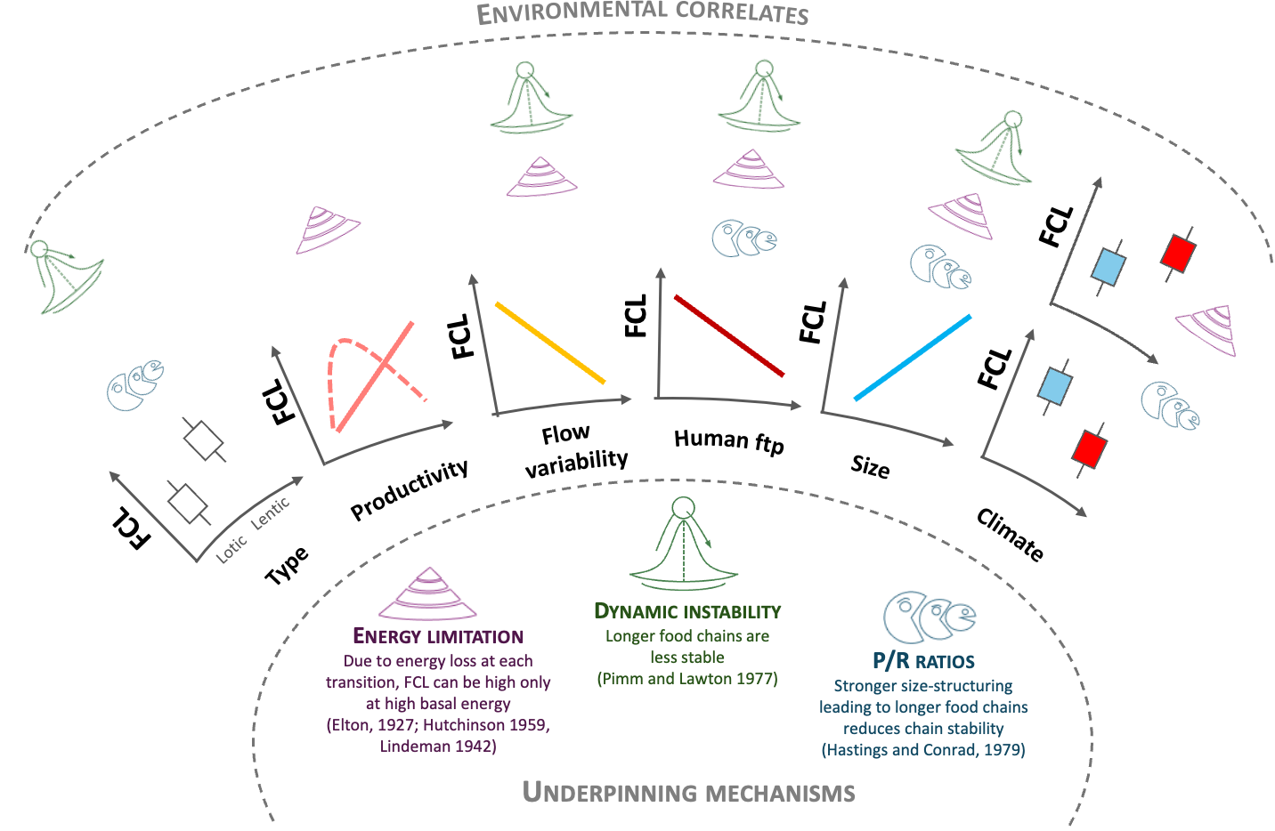

Slide 5
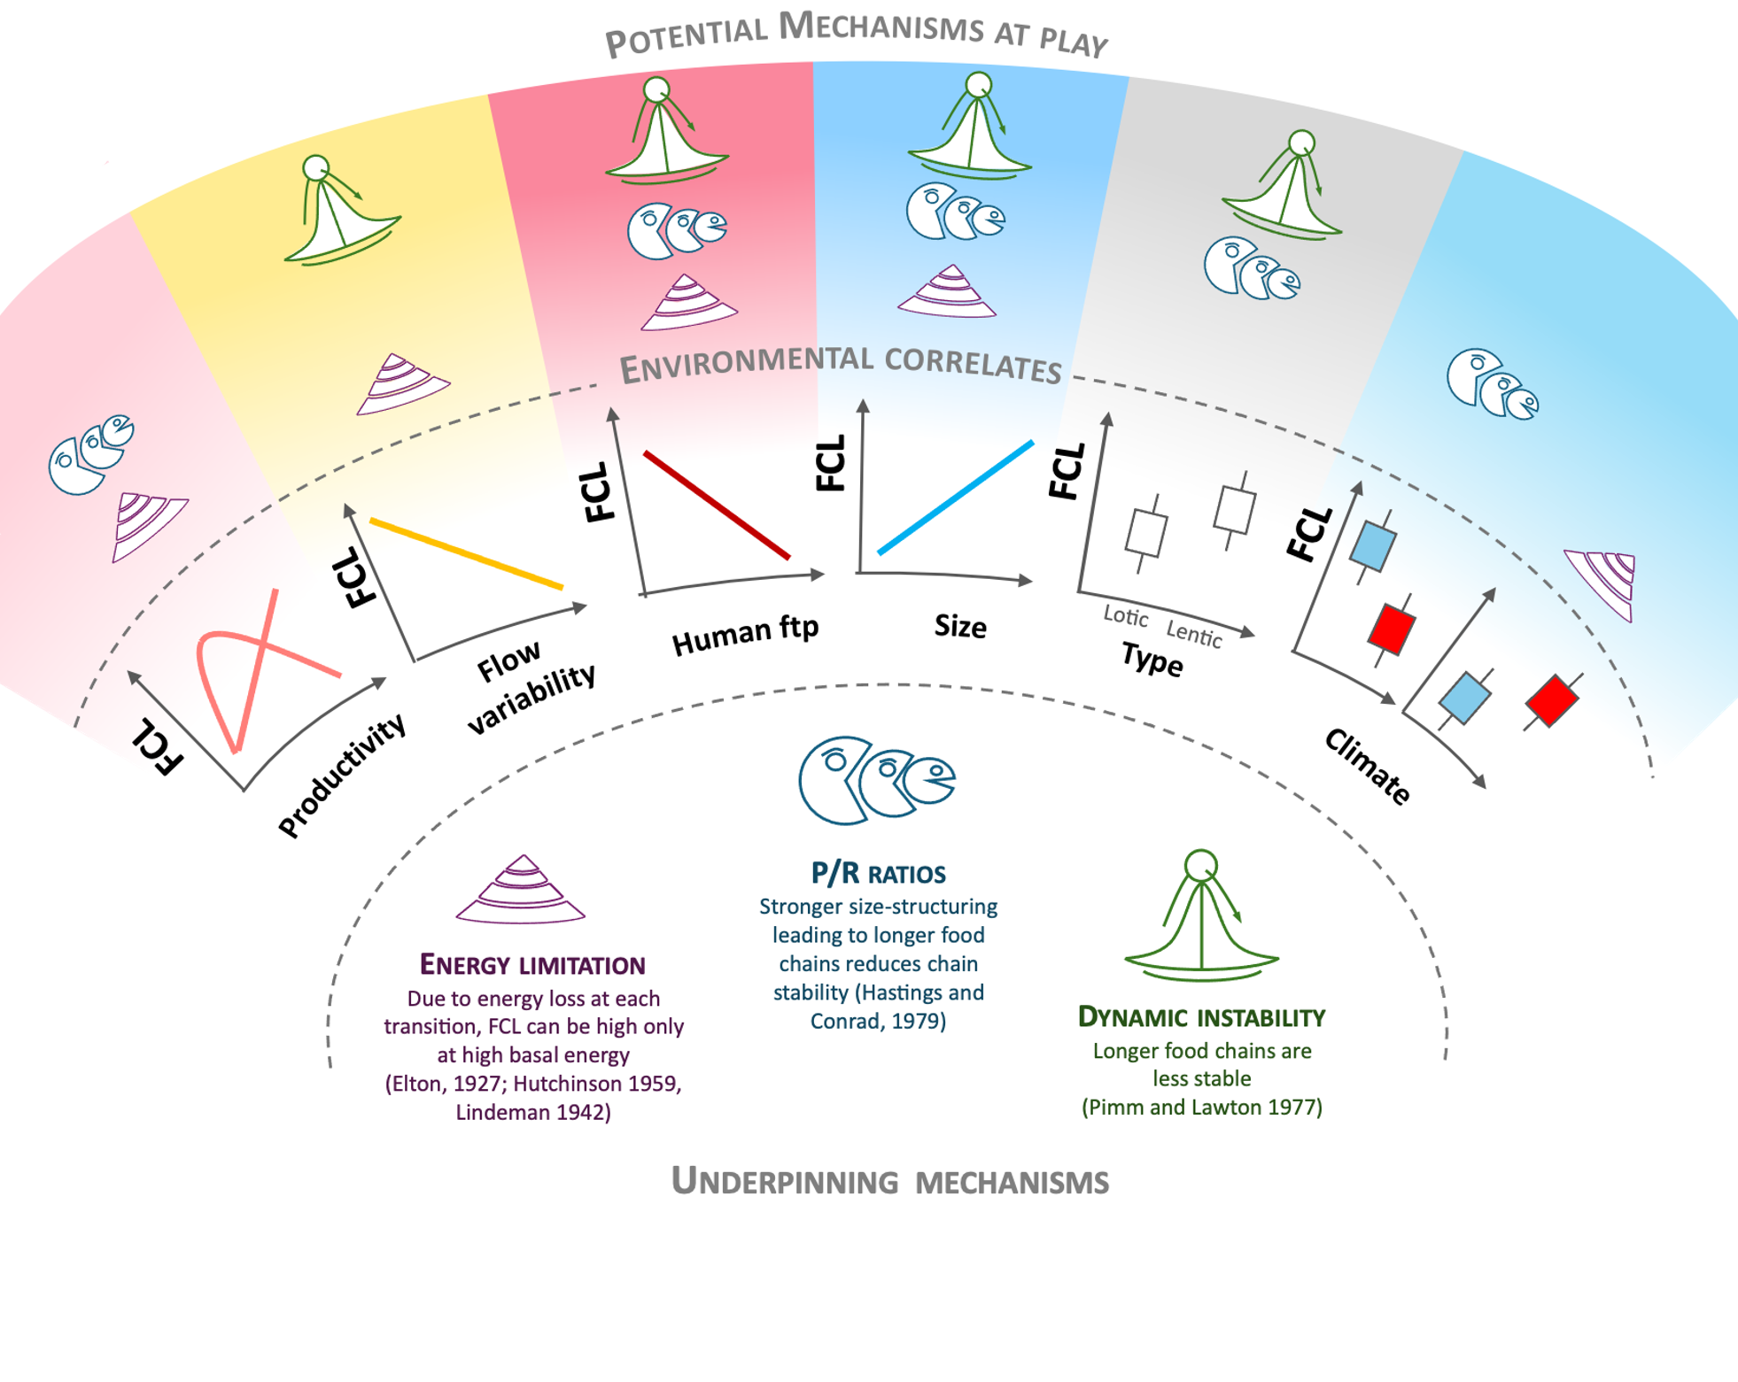

Slide 6
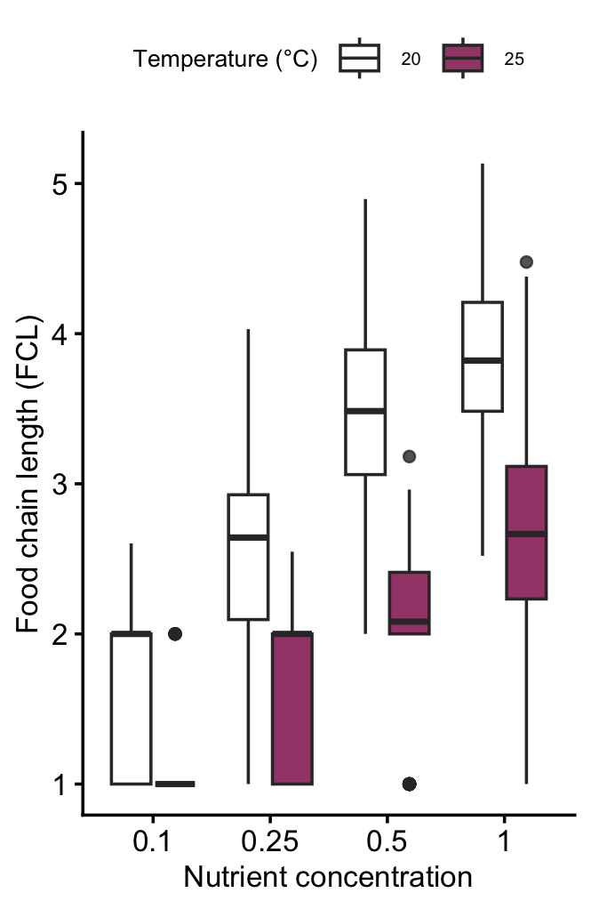
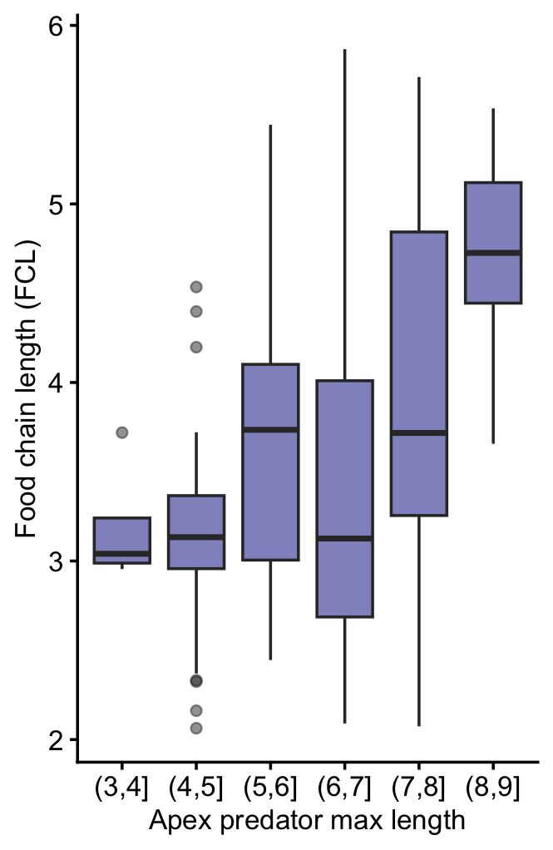
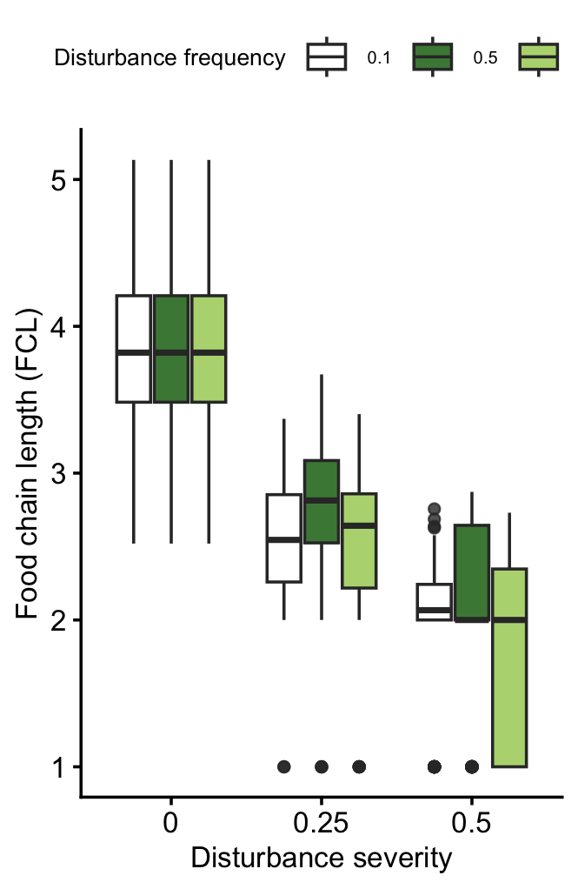
Energy limitation
Size-structure
Dynamic instability
Richness
Coming soon…
Larger ecosystem ->
More productive
Larger ecosystem>
greater richness
FCL
Ecosystem size

Slide 7
Energy limitation
Size-structure
Dynamic instability
Richness
Coming soon…
Larger ecosystem ->
More productive
Larger ecosystem>
greater richness
FCL
Ecosystem size

Slide 8
Long-observed correlation
Larger ecosystem
Greater stability
FCL
Larger ecosystem
Greater richness
Ecosystem size
Larger ecosystem
Larger predators
Larger ecosystem
More productivity
warmer ecosystem
Greater energetic loss
Warmer ecosystem
smaller predators
Coming soon…
Richness
Energy limitation
Size-structure
Dynamic instability

Slide 9
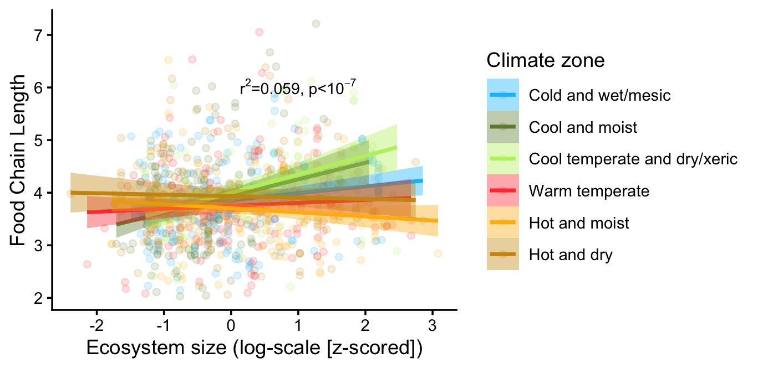
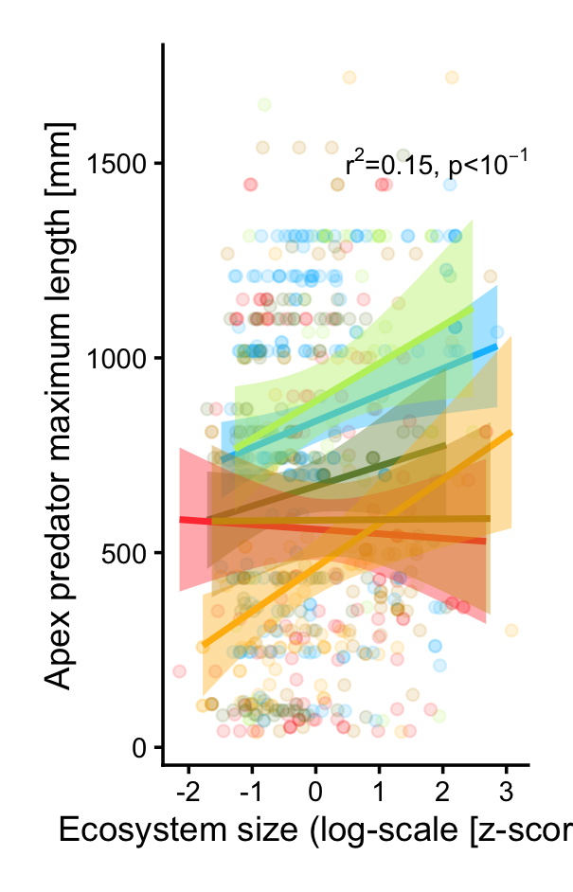
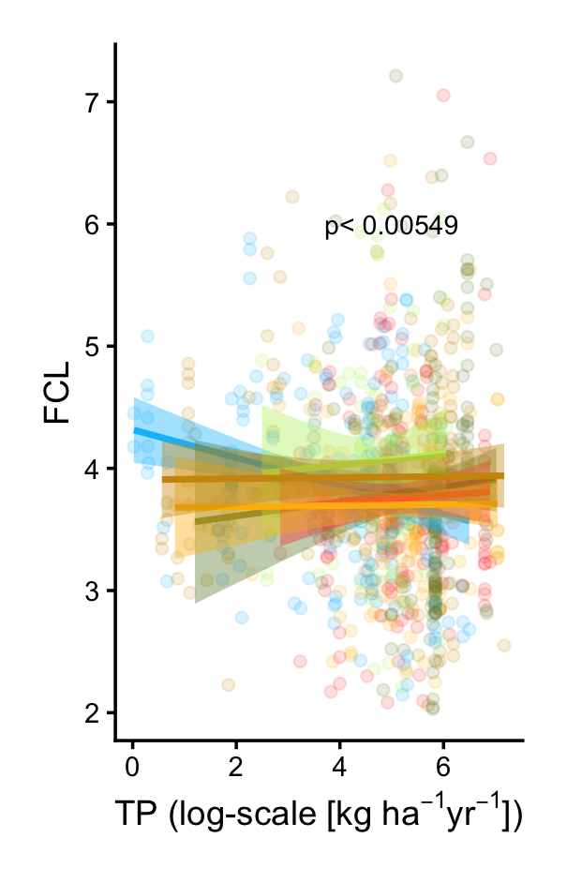
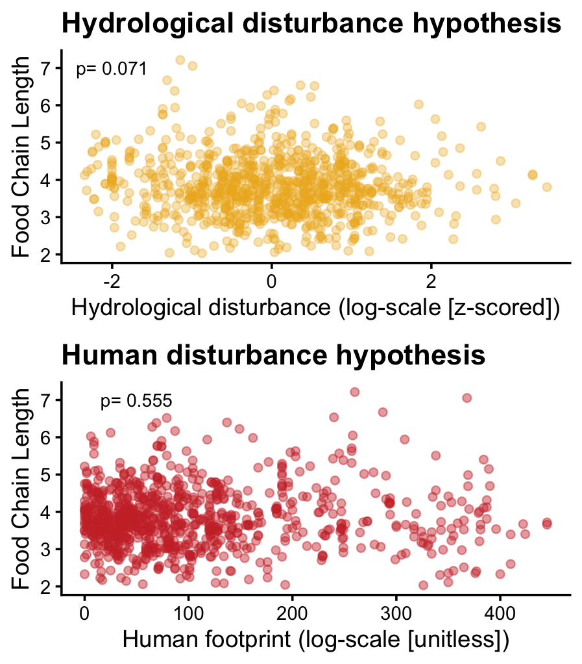
Long-observed correlation
Larger ecosystem
Greater stability
Larger ecosystem
Greater richness
Larger ecosystem
Larger predators
Larger ecosystem
More productivity
warmer ecosystem
Greater energetic loss
Warmer ecosystem
smaller predators
Coming soon…
Richness
Energy limitation
Size-structure
Dynamic instability

